Slide 1
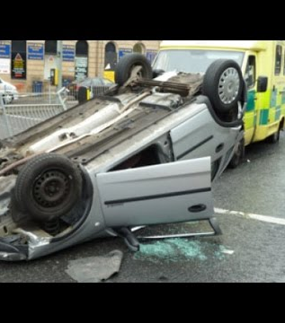
Analysis of Motor Vehicle Crashes
(2014,2015 and 2016)

Slide 2
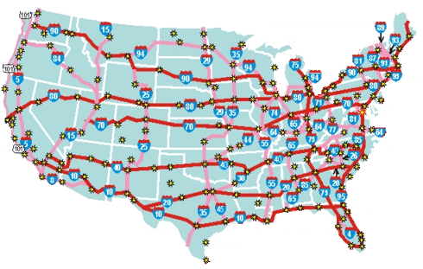
The United States
264 million vehicles registered
218 million drivers
This Photo by Unknown Author is licensed under CC BY-SA-NC
https://www.statista.com/topics/3708/road-accidents-in-the-us/

Slide 3
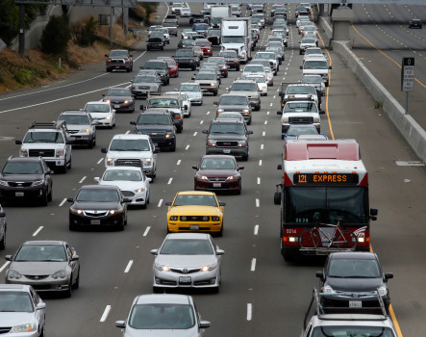
The United States
Busiest Country in terms of road traffic:
264 million vehicles registered
218 million drivers
Number of collisions/accidents have increased significantly…
Multiple factors contributing to accidents – road safety, driver skill, impairment due to alcohol, notably speeding etc
Important to understand the top causes contributing to increase in accidents and take actions to increase safety

Slide 4
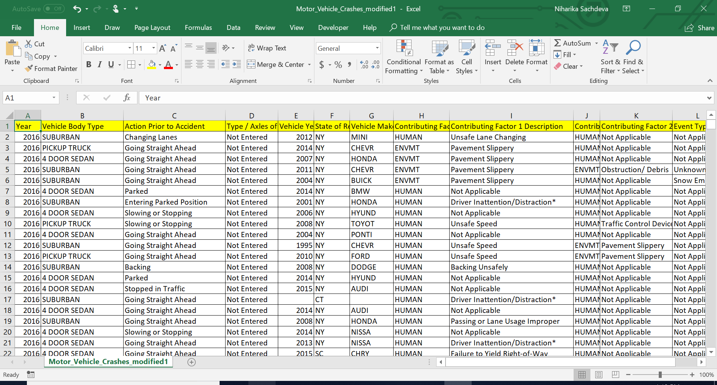
CSV FILE – “MOTOR VEHICLE CRASH”

Slide 5
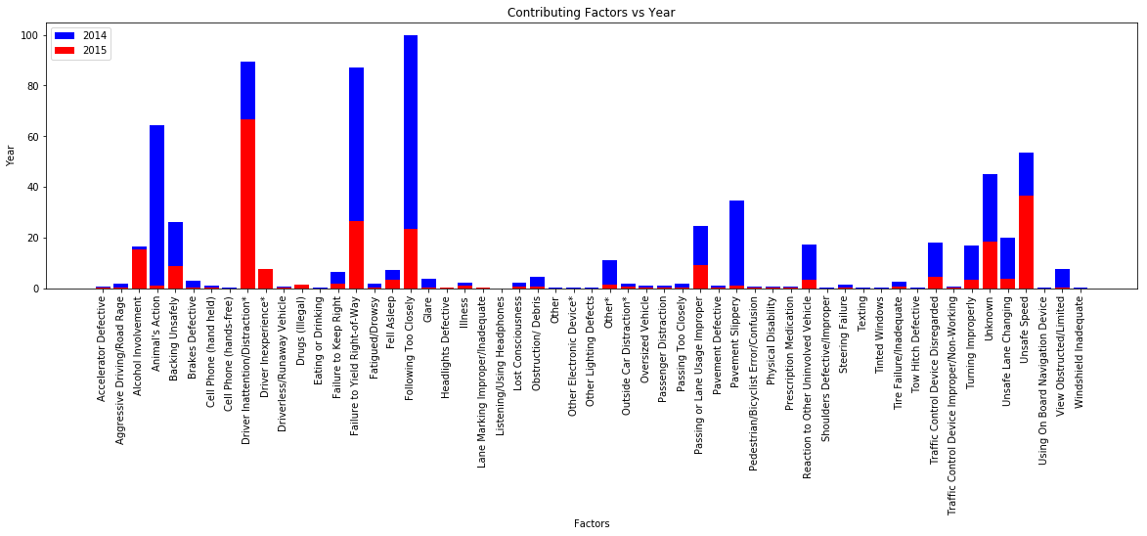
Top 5 factors contributing to accidents
Top 5 factors contributing to accidents:
Following too closely
Failure to yield right-to-way
Driver Inattention/distraction
Animal’s action
Unsafe speed
Factors that have resulted in more accidents in 2015 than 2014 are
Driver Inattention/distraction
Unsafe speed
Alcohol Involvement
We infer that stringent control/penalties on alcohol involvement, use of mobile phones while driving and better driving habits can help reduce the accidents

Slide 6
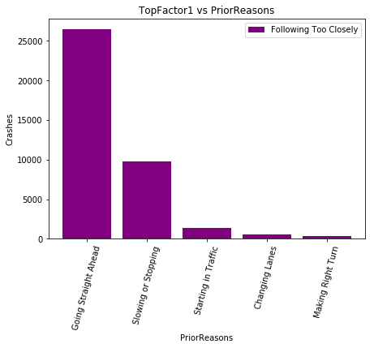
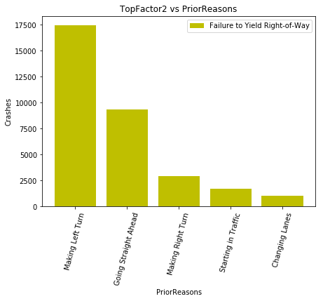
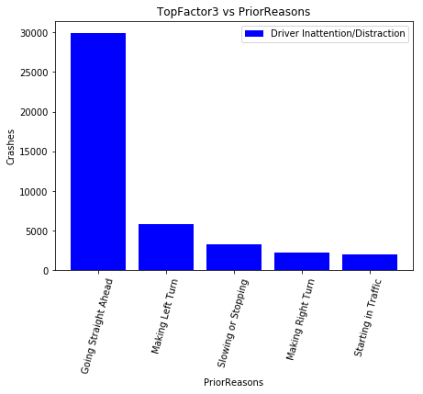
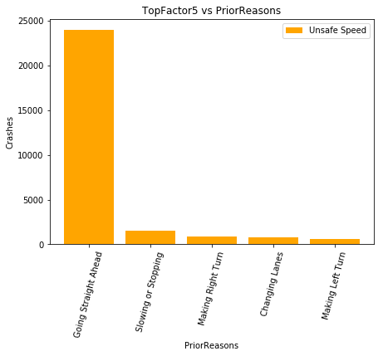
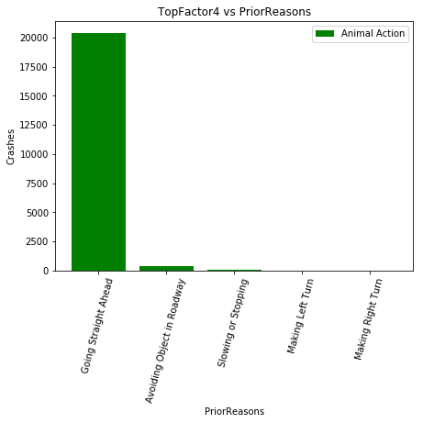
Top 5 factors contributing to accidents
We analyzed what happened before the accident in top five contributing factors and inferred:
Going straight ahead is common across all accident types. Which means that its not caused by the car but due to human causes – bad driving habits, alcohol involvement, speeding etc
Slowing or stopping is another common occurrence:

Slide 7
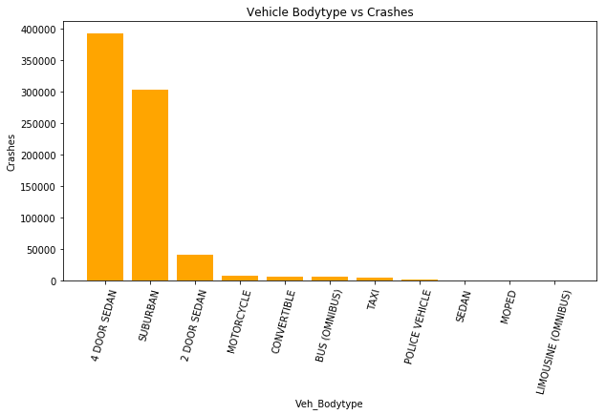
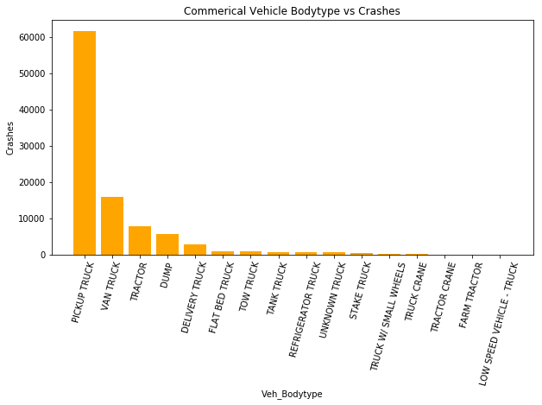
Passenger Vehicle Body Type
Commercial Vehicles
Pickup Truck shows the maximum
count
Commercial Vehicle Body Type
Passenger Vehicles
Sedan Cars encountered max crashes.
Suburban is the next.

